Slide 1

Enhancing Crop Production in India: A Machine Learning Analysis

Slide 2

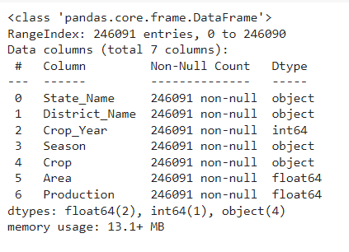
Info of the dataset

Slide 3


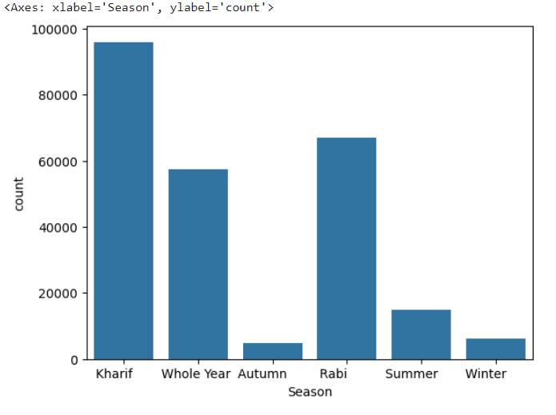
Introduction
The in India
plays a crucial role in the economy. This presentation explores the use of machine or deep learning to
enhance address
and challenges faced by
farmers. We will discuss the potential of data-driven solutions in optimizing agricultural practices.
Countplot of the seasons with kharif being the highest among all and rabi the second highest.

Slide 4



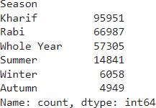
Challenges in Crop
Production
and
pose signiﬁcant challenges to crop production in India. Traditional farming methods often struggle to adapt to these conditions. This slide will examine the key obstacles faced by Indian farmers.
Value Counts per season means total number of crops in each season and as shown here the data type of these values is integer54

Slide 5



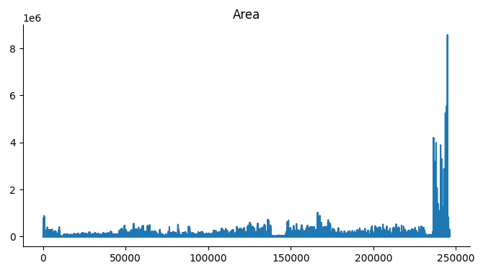
Role of Machine Learning
Machine learning offers the potential to revolutionize
,
, and
. By
leveraging advanced algorithms, it becomes possible to analyze vast amounts of data and derive actionable insights for farmers.
Plot of area: It signiﬁes how much are is available in total and how much area is occupied. With the help of this one can understand how area is occupied and how much can be given

Slide 6
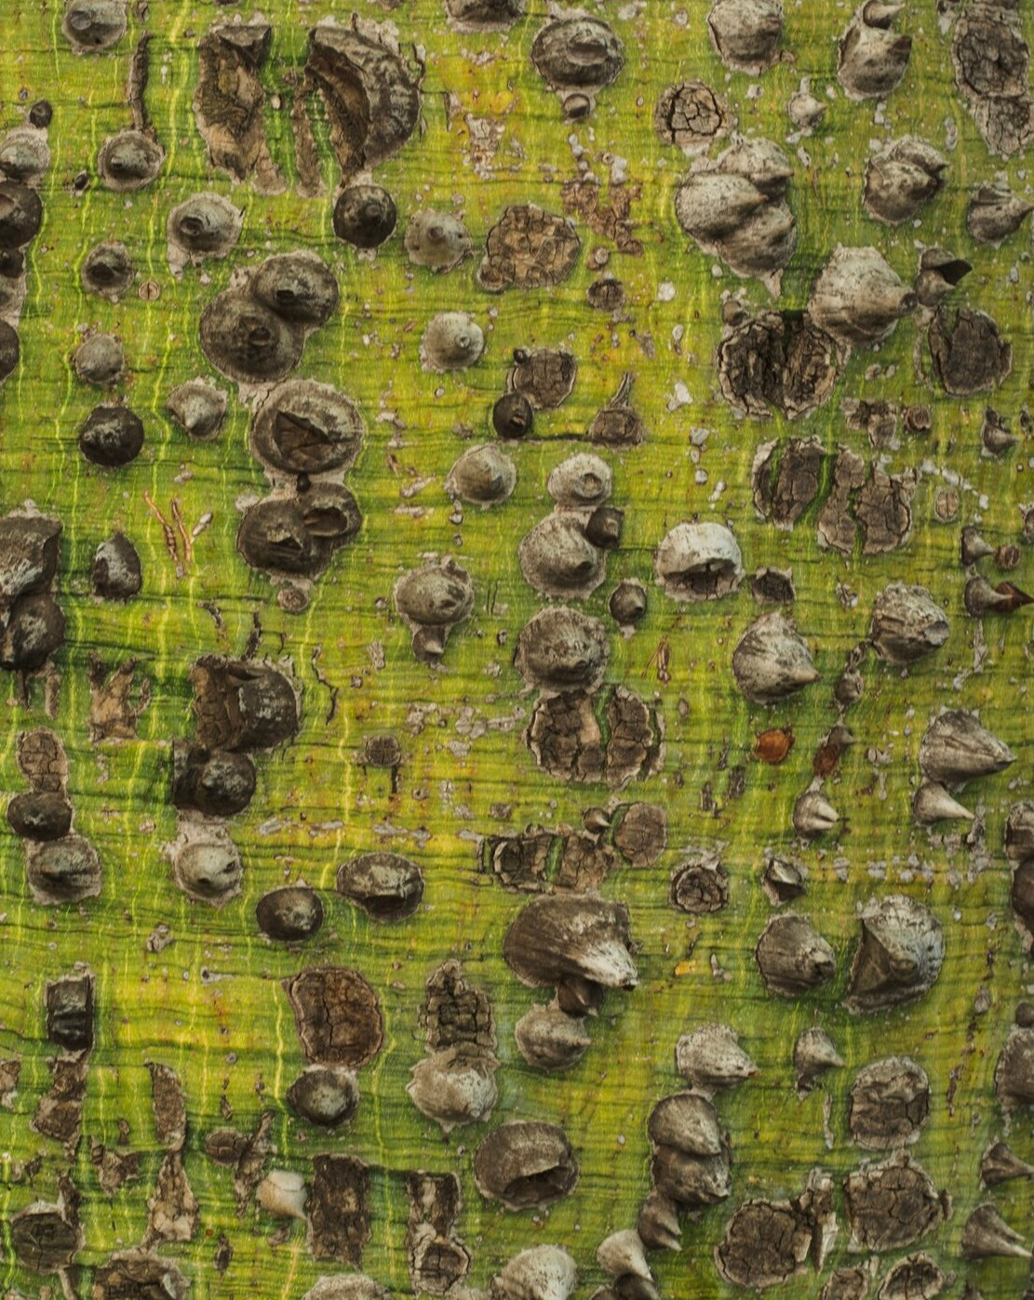


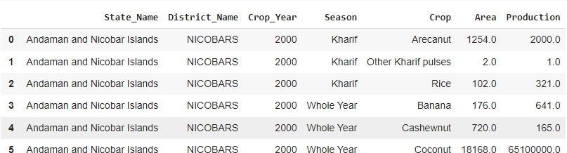
Data Collection
Accurate and comprehensive
is essential for effective machine learning models. This slide will
explore the various sources of
agricultural
,
.
data, including
, and
The dataset for the analysis of for this crop production analysis in India is a cleaned dataset present on kaggle.

Slide 7




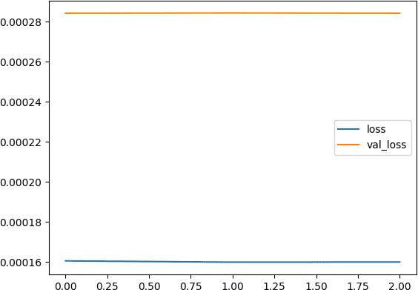
Crop Yield Prediction
Machine analyze accurate
learning historical
algorithms can data to make
. By
such as
, and
considering factors
,
, these models can provide valuable insights for farmers.
This is the plot that shows the overall performance of the model and according to this the loss and validation loss of the model is very less hence model is performing well.

Slide 8



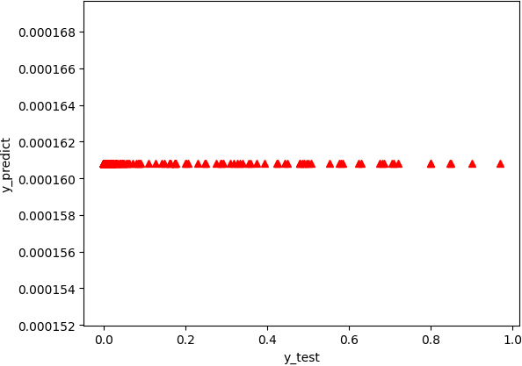
Disease Detection
Early detection of is critical for minimizing losses. Machine
to identify signs of disease, enabling
learning can analyze
farmers to take proactive measures to protect their crops.
Plotting the predicted values, which are predicted by the model, it is represented by the y_test on x axis and y_predicted on the y axis

Slide 9




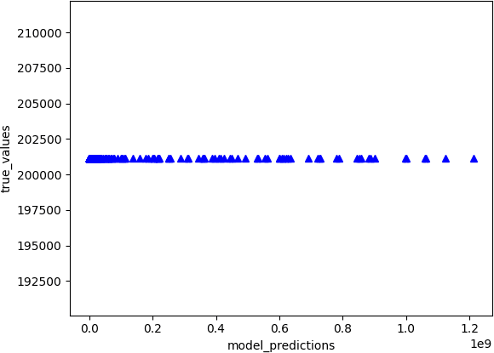
Resource Optimization
Optimizing the use of , , and is essential for sustainable crop production. Machine learning can recommend precise application rates based on real-time data, reducing waste and environmental impact.
Plotting the true values, which are it is represented by the true_predictions on x axis and true_values on the y axis

Slide 10
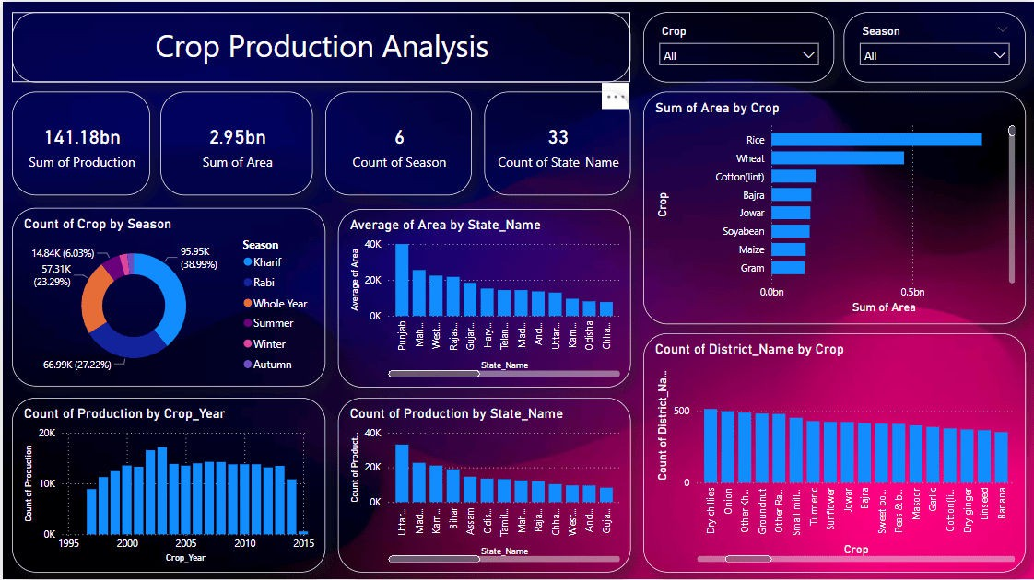
Dashboard of the project

Slide 11
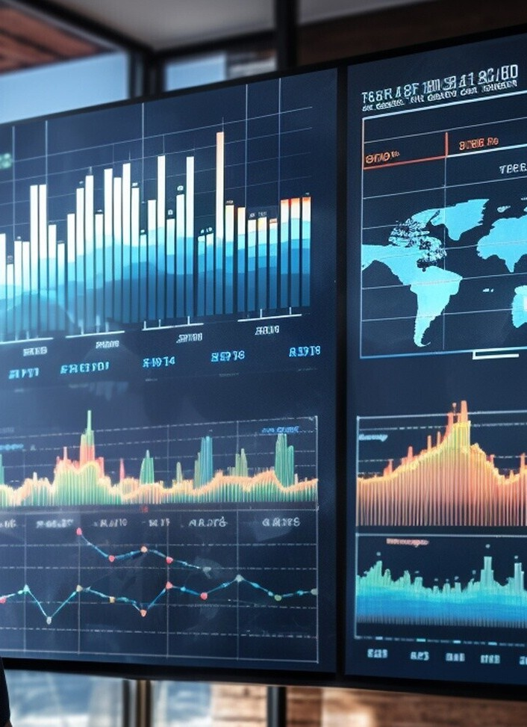
Some point related to the dashboard
Overall Production and Area Summary: Total crop production is 141.18 billion units. Total area under cultivation is 2.55 billion units. There are 5 distinct seasons and 33 states represented.
Crop Distribution by Season: The largest portion of crops (38.55%) is grown in the Rabi season. Other seasons include Kharif (27.22%), Whole Year (5.03%), Summer (23.55%), and Autumn (0%).
Average Area by State: Punjab has the highest average area under cultivation. Other notable states include Maharashtra, Uttar Pradesh, Rajasthan, Gujarat, and Tamil Nadu.
Production Trends Over the Years: Crop production data spans from 1555 to 2015. Production peaked in the early 2000s and then showed fluctuations.
State-wise Production: Uttar Pradesh and Punjab have the highest crop production. Other major producers include Madhya Pradesh, Karnataka, Assam, and Bihar.
5. Crop Area Analysis: Rice occupies the largest area of cultivation, followed by Wheat, Cotton (lint), Bajra, Jowar, Soyabean, Maize, and Gram.
7.District-wise Crop Distribution: Districts growing dry chillies have the highest count. Other widely grown crops include Onion, Coconut, Other Rabi, Ginger, and Small Millets.

Slide 12



Future Prospects
Looking ahead, the integration of machine learning in agriculture holds immense potential for , ,
and . This slide will explore the future prospects and opportunities in this ﬁeld.

Slide 13
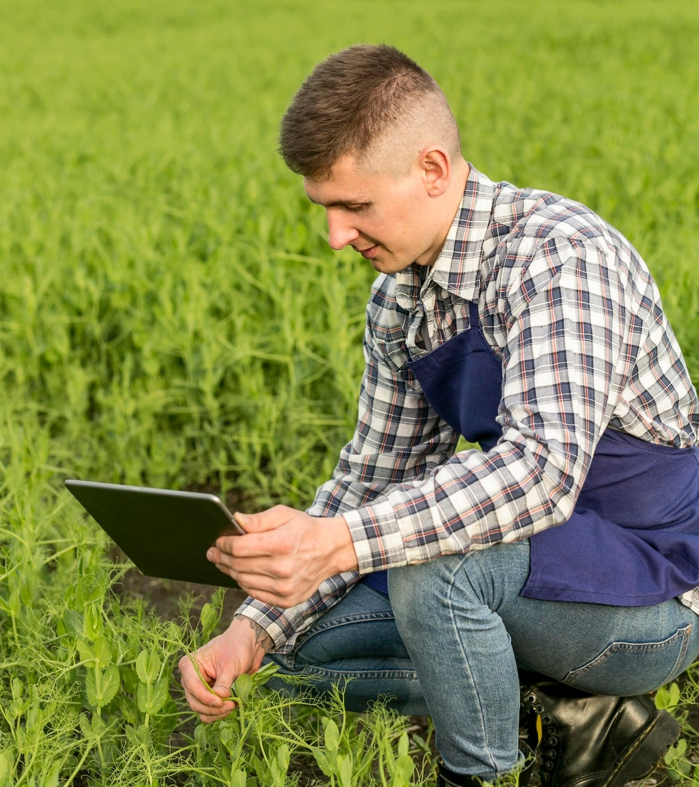

Policy Implications
Effective can
play a pivotal role in promoting the adoption of machine learning in agriculture. This slide will discuss the policy implications and recommendations for creating an enabling environment for technological advancements.

Slide 14
Conclusion
In conclusion, the application of machine learning has the potential to revolutionize crop production in India. By addressing challenges, optimizing resources, and empowering farmers with data-driven insights, we can pave the way for a more sustainable and prosperous agricultural sector.

Slide 15
Thanks!
Do you have any questions? suyashpandey9611@gmail.com
+91 7905174871

